Slide 1
Introduction to the Gospel Media App

Slide 2
Say Hello to the Gospel Media App
App version of Gospel Media on ChurchofJesusChrist.org
Largest collection of Church media
Download media to your mobile device and show it without using the internet
iOS and Android mobile phones and tablets
Download free from your app store
Notes:
SAY: The Gospel Media app is a presentation tool that makes using images, music and videos easier in many different teaching situations.
It is the app version of Gospel Media on ChurchofJesusChrist.org.
It is the largest collection of Church media anywhere.
It allows you to download media to your mobile device and show it without relying on the internet.
It is available for iOS and Android mobile phones and tablets
It can be downloaded free from your mobile device’s app store.
ASK: Why is it important to be able to download media and show it without the internet? (Sometimes the internet is slow or unreliable. This can cause interruptions in a lesson. Downloading media before a lesson allows you to play it more easily and without interruption.)

Slide 3
How can you use the Gospel Media app when preparing lessons?
Notes:
SAY: How can you utilize the Gospel Media App to make your lessons more powerful and memorable by adding images, music and videos to your lesson.

Slide 4
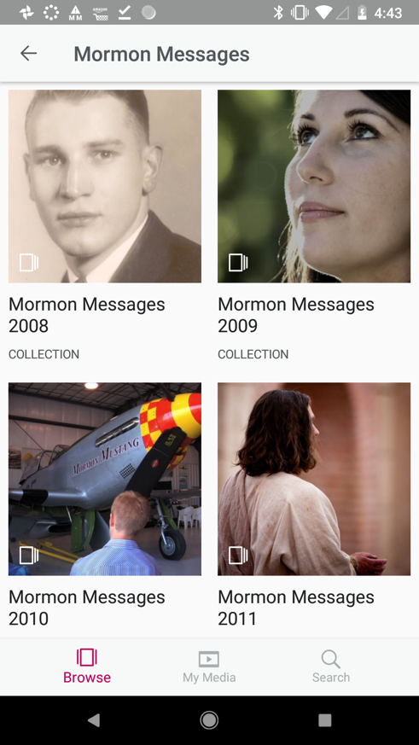
Sunday School Teacher
Notes:
SAY: Do you teach youth Sunday School classes?
Maybe you want to include Inspirational Message videos, images, and music from EFY in your lessons? And maybe you want to show it on a television in your classroom?

Slide 5
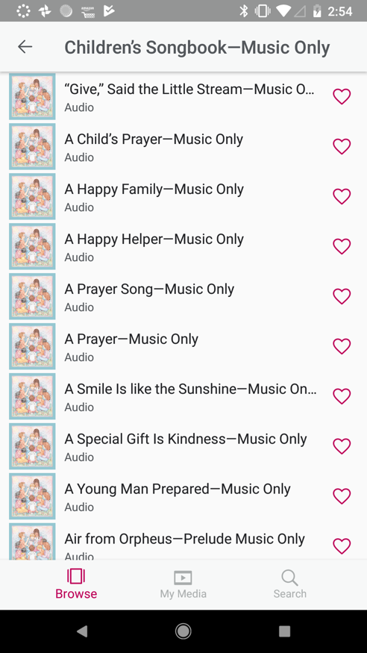
Primary Chorister
Notes:
SAY: Or maybe you’re a primary chorister without a piano and you need to teach the junior primary three songs from different parts of the Children’s Songbook?

Slide 6
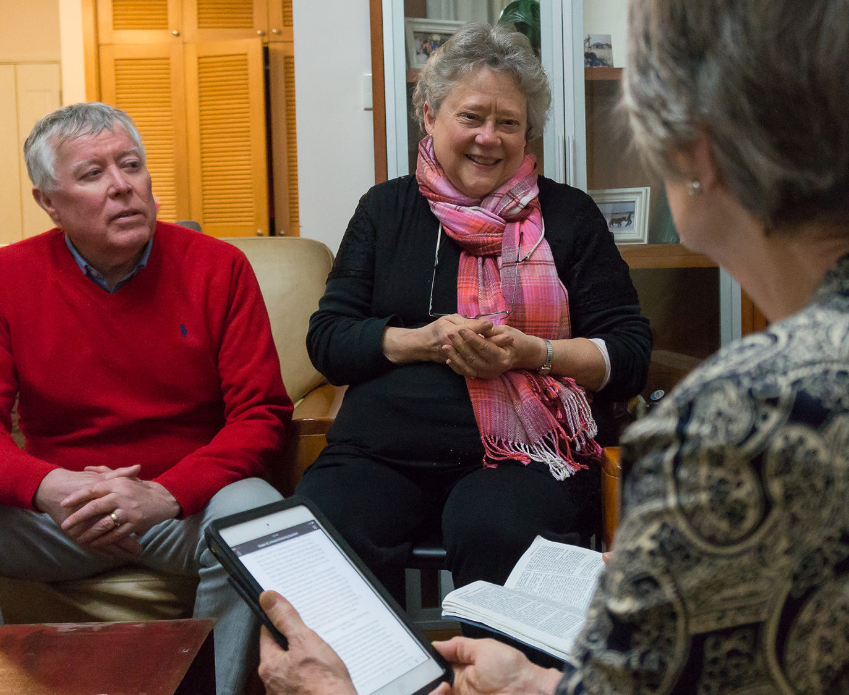
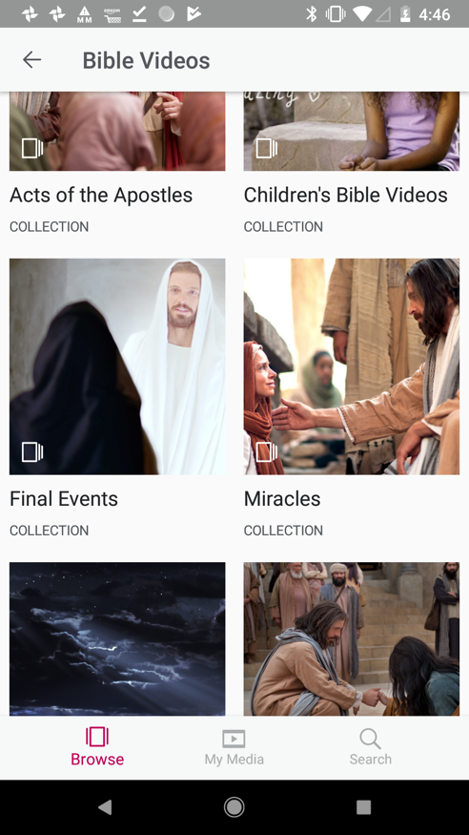
Ward Missionary
Notes:
SAY: Are you a ward missionary who is preparing a lesson for someone who has questions about Christ? Maybe you would like to show some Bible Videos and a video describing the basic beliefs of Church members.

Slide 7
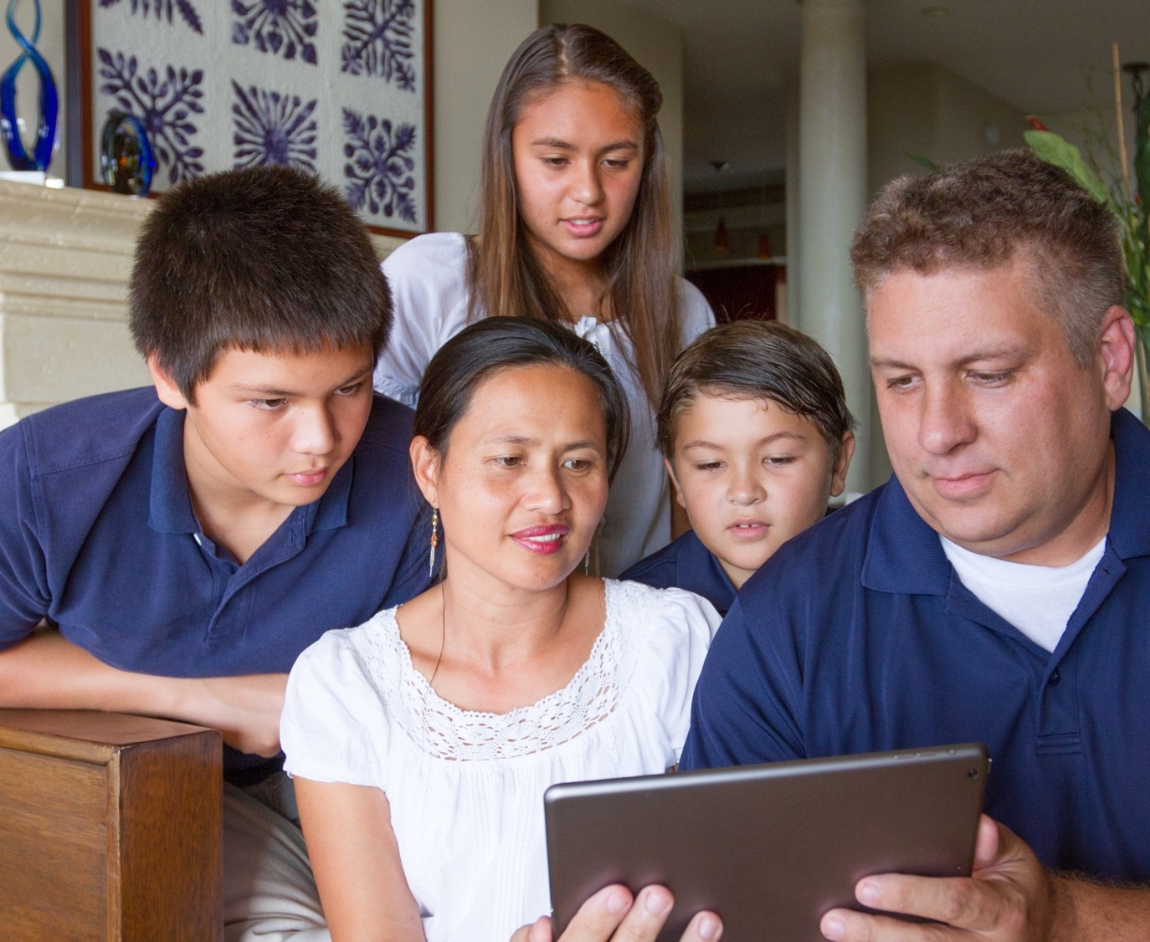
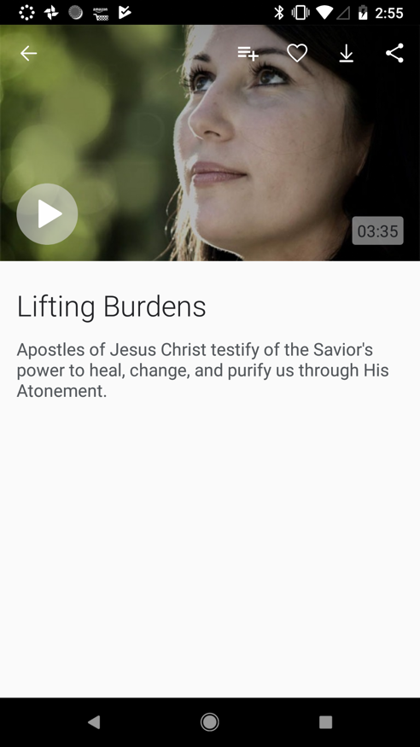
Lessons in the Home
Notes:
SAY: You may be a preparing a Home Evening lesson on Christ’s Atonement, and the “Lifting Burdens” video would be perfect to help people understand this doctrine.

Slide 8
With the Gospel Media app, you can:
Browse and Search
Mark Favorites
Download Media
Create Presentations
Add Speaker Notes
Trim Video and Music
View Presentation
Share with Others
Access Settings
Notes:
SAY: Gospel Media can help you in all of these situations and more. Let’s see how the Gospel Media app works.
With the app, you can:
Easily browse and search for media
Mark favorites so you can quickly find them later
Download media to your device for viewing offline
Trim video and audio to play only the part you want
Group media into presentations
Add speaker notes
Use Presenter Mode to view a presentation on a second screen
Share media and presentations with others
Manage downloaded media on your device
We won’t be able to cover everything the app does within our time, but we will give you a brief overview of the main functions.

Slide 9
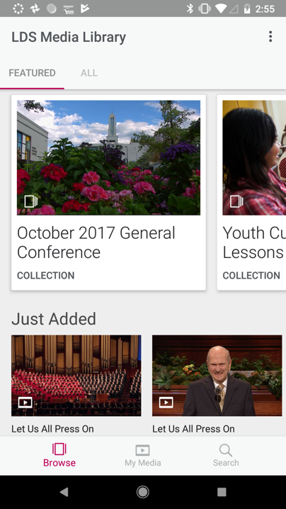
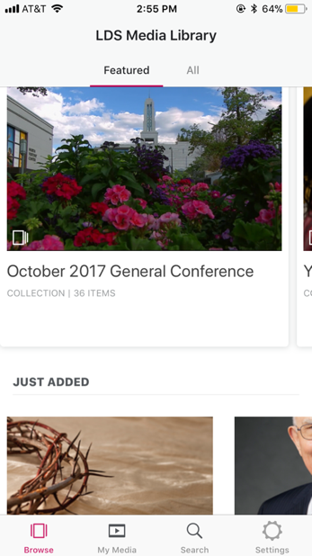
Browse and Search
How to browse media
Notes:
SAY:
To browse media, all you have to do is open the app.

Slide 10
Browse and Search
How to browse media
Notes:
SAY:
The first screen you will see is the Browse screen.

Slide 11
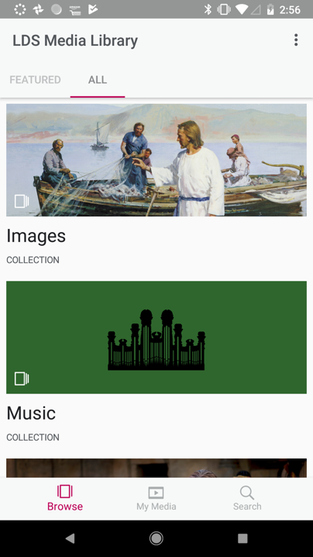
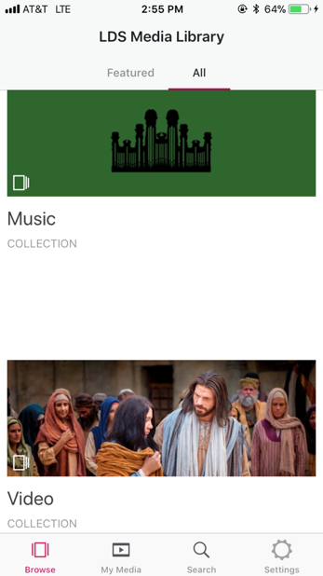
Browse and Search
How to browse media
Notes:
SAY:
It shows media that is featured and that has recently been added.

Slide 12
Browse and Search
How to browse media
Notes:
SAY:
If you tap All, it shows you all the media, divided into videos, images, and music collections.

Slide 13
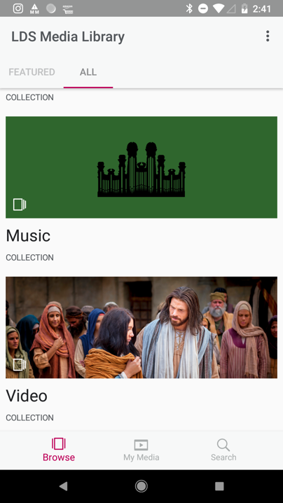
Browse and Search
How to browse media
Notes:
SAY:
Collections are further divided into categories to help you quickly find what you are looking for.

Slide 14
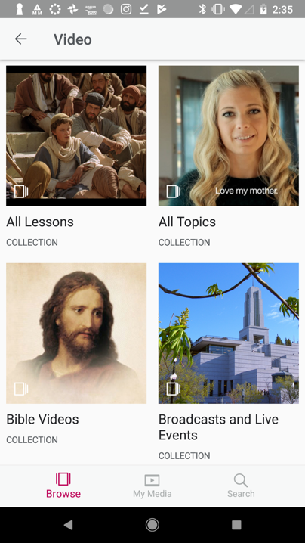
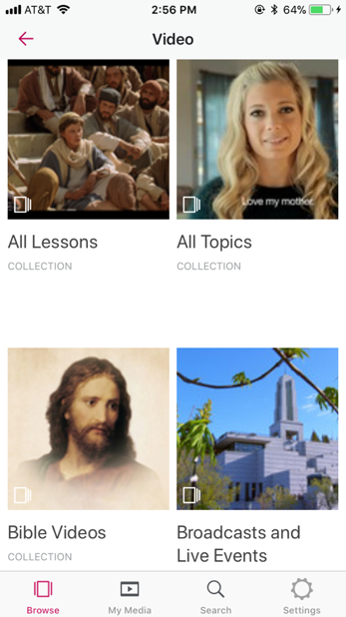
Browse and Search
How to browse media
Notes:
SAY:
Video and image collections match what you would find in Gospel Media on ChurchofJesusChrist.org.

Slide 15
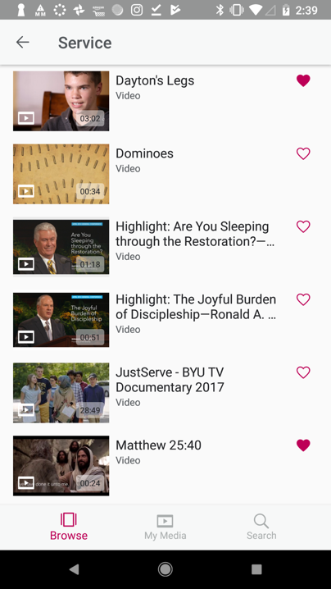
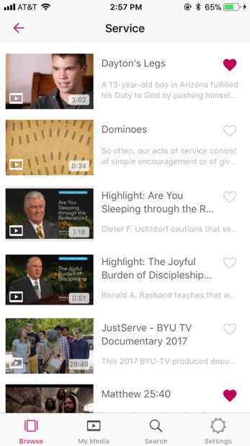
Browse and Search
How to browse media
Notes:
SAY:
You can preview, favorite, download, and add media to presentations while browsing to see what is available.

Slide 16
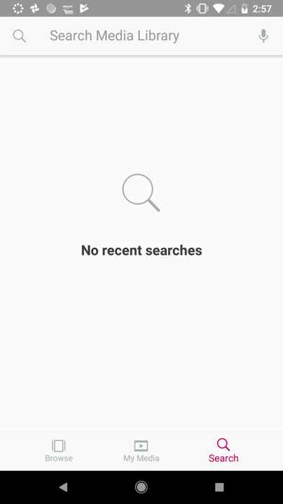
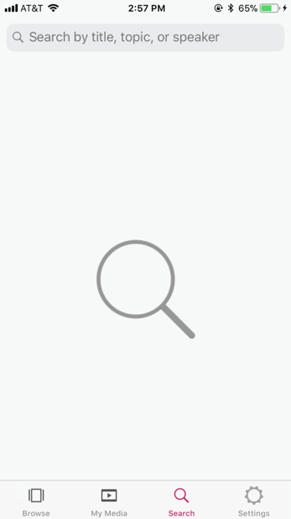
Browse and Search
How to search media
Notes:
SAY: You can also use the Search function to find media. Enter any keyword or title and you get a list of media related to that term.

Slide 17
Browse and Search
How to search media
Notes:
SAY: The Search function is found in the bottom bar in the app.

Slide 18
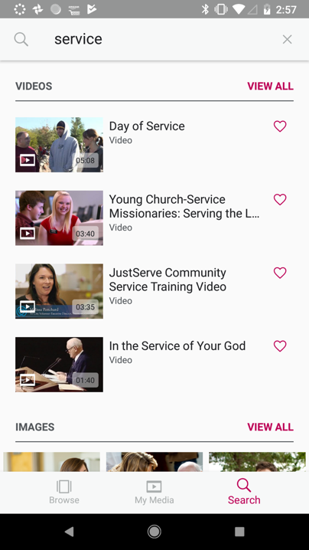
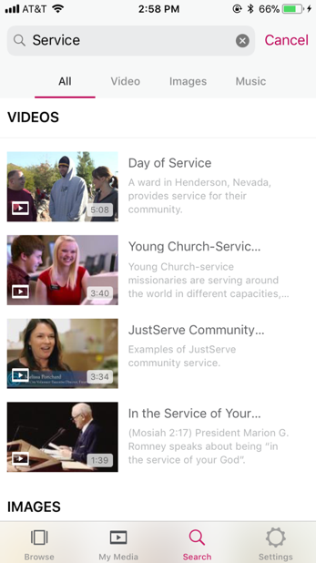
Browse and Search
How to search media
Notes:
SAY: Type in a keyword for what you’re looking for.
By default, all media types will be displayed. You can further filter by tapping on the Videos, Image, and Music option at the top.

Slide 19
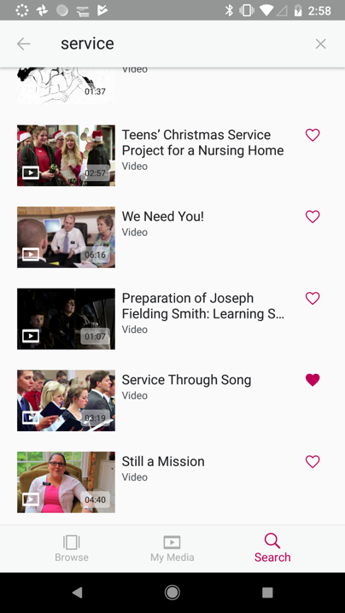
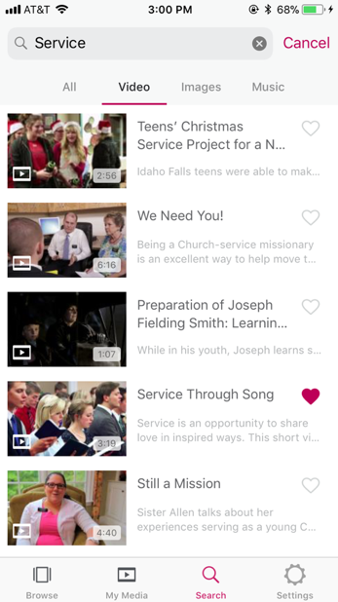
Mark Favorites
How to favorite media
Notes:
SAY: Another way to help you find media quickly is to mark favorite items.
If you are looking through the library and see an item you might be interested in, or want to look at later, tap the heart at the top of the screen.
To see your favorites, tap My Media and then Favorites.
Keep in mind, if you Favorite an item it is not downloaded to your device. We’ll talk about downloading on the next slide.

Slide 20
Mark Favorites
How to favorite media
Notes:
SAY: Another way to help you find media quickly is to mark favorite items.
If you are looking through the library and see an item you might be interested in, or want to look at later, tap the heart at the top of the screen.
To see your favorites, tap My Media and then Favorites.
Keep in mind, if you Favorite an item it is not downloaded to your device. We’ll talk about downloading in a few moments.

Slide 21
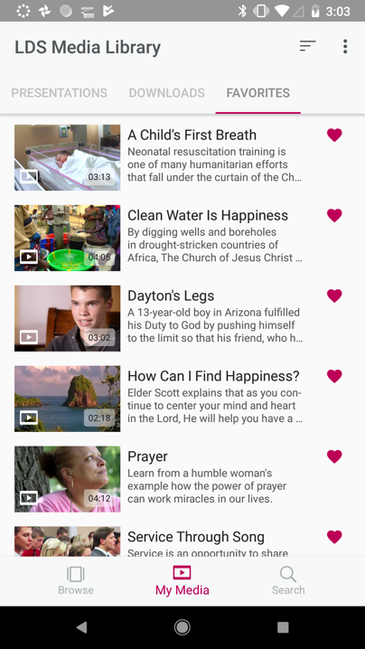
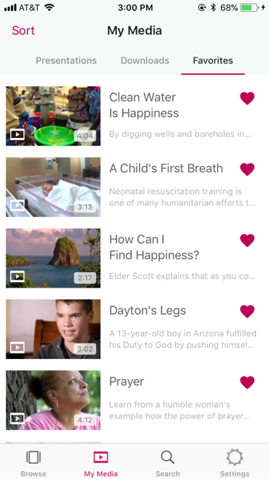
Mark Favorites
How to view favorites
Notes:
SAY: To view all of the media you have favorited, tap on the My Media icon in the bottom bar.
You will tap on the Favorites tab in the top right.

Slide 22
Mark Favorites
How to view favorites
Notes:
SAY: To view all of the media you have favorited, tap on the My Media icon in the bottom bar.
You will tap on the Favorites tab in the top right.

Slide 23
Mark Favorites
How to sort favorites
Notes:
SAY: Favorites can be sorted by tapping on the Sort option.
For Apple devices it’s in the top left corner. For Android it’s in the top right corner.

Slide 24
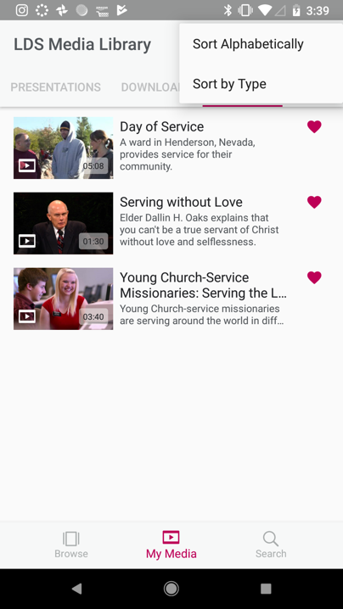
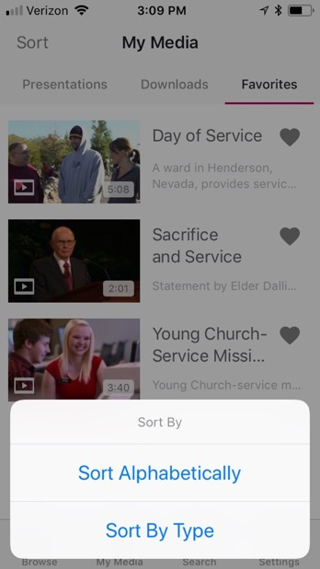
Mark Favorites
How to sort favorites
Notes:
SAY: Sorting allows you to view your media by media type or alphabetically.

Slide 25
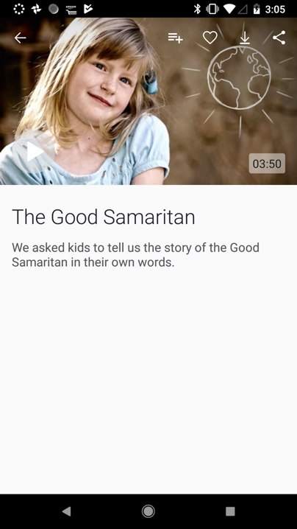
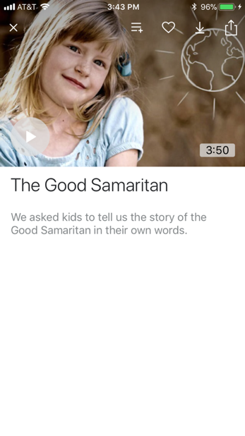
Download Media
How to download video
Notes:
SAY: As we mentioned before, the internet can sometimes be slow, unreliable or not exist at all and make it difficult to present media. With the Gospel Media app, you can avoid this problem by downloading media beforehand and playing it from your device. Let’s look at how this is done.

Slide 26
Download Media
How to download video
Notes:
SAY: When viewing media while browsing or when searching, you will notice a download icon with a down arrow. Tap on that and the media will download to your device.
Depending on the file size of the media, it may take a few minutes for it to download.
You know it is finished downloading when the download icon changes to a delete icon.
Tapping the delete icon, deletes the media from your device.
Remember, it’s best if you download before coming to Church when you have reliable internet.

Slide 27
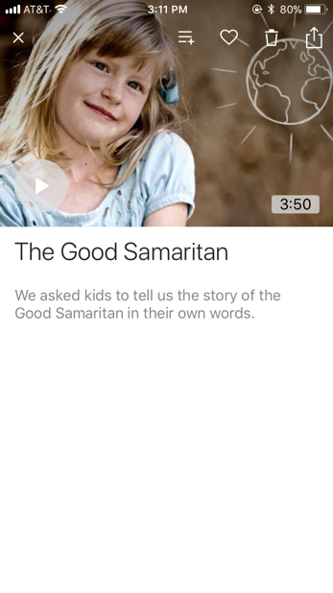
Download Media
How to download video
Notes:
SAY: The icon will change once the media has been downloaded.

Slide 28
Download Media
How to download video
Notes:
SAY: On an Apple device, it will change to a trash can icon where you can delete it if you no longer wanted it downloaded. On an Android, it will change to a check mark icon.

Slide 29
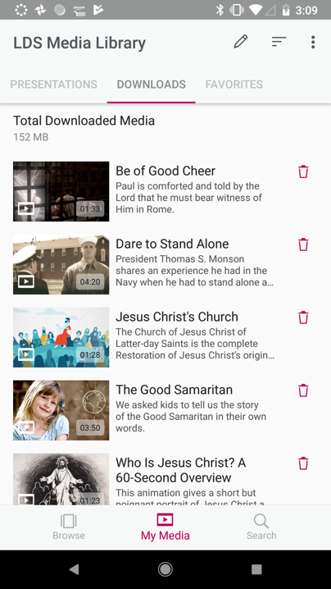
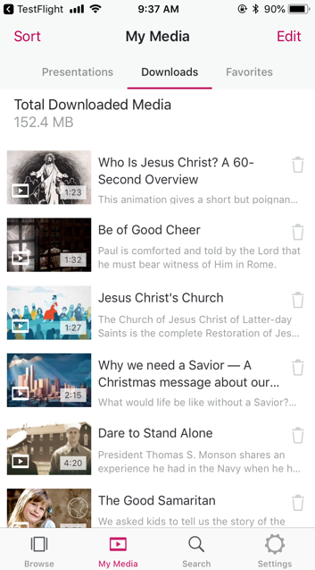
Download Media
How to view downloads
Notes:
SAY: To view all of the media that you’ve downloaded, tap on the My Media icon in the bottom bar. You will then tap on the Downloads Tab at the top.
All of the media that has been downloaded to your device through the app will be displayed.
From this screen you can SORT, PLAY, VIEW or DELETE the media from your device.

Slide 30
Download Media
How to view downloads
Notes:
SAY: To view all of the media that you’ve downloaded, tap on the My Media icon in the bottom bar. You will then tap on the Downloads Tab at the top.
All of the media that has been downloaded to your device through the app will be displayed.
From this screen you can SORT, PLAY, VIEW or DELETE the media from your device.

Slide 31
Download Media
How to delete downloads
Notes:
SAY: Tapping the Trash can icon, deletes the media from your device.
Remember, its best if you download before coming to Church when you have reliable internet.

Slide 32
Download Media
How to delete multiple downloads
Notes:
SAY: To delete more than one item at a time, Tap on the Edit option in the top Right.
On an Apple Device, it will say Edit. On an Android device, it will display as a pencil icon.
You will then be able to see how big each file is, tap on more than one and then tap on the Delete button or Trash can icon to remove the media from your device.

Slide 33
Download Media
How to delete multiple downloads
Notes:
SAY: To delete more than one item at a time, Tap on the Edit option in the top Right.
On an Apple Device, it will say Edit. On an Android device, it will display as a pencil icon.
You will then be able to see how big each file is, tap on more than one and then tap on the Delete button or Trash can icon to remove the media from your device.

Slide 34
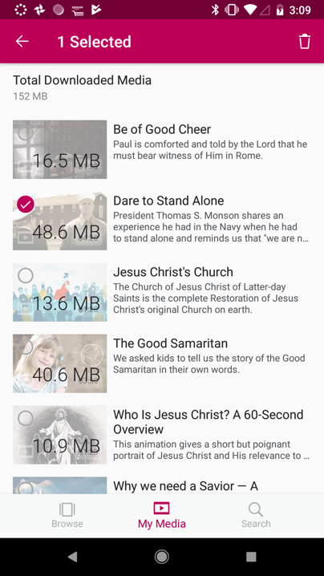
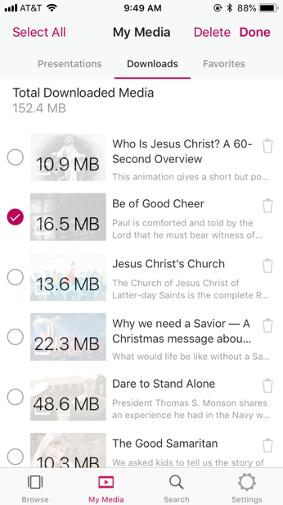
Download Media
How to delete multiple downloads
Notes:
SAY: To delete more than one item at a time, Tap on the Edit option in the top Right.
On an Apple Device, it will say Edit. On an Android device, it will display as a pencil icon.
You will then be able to see how big each file is, tap on more than one and then tap on the Delete button or Trash can icon to remove the media from your device.

Slide 35
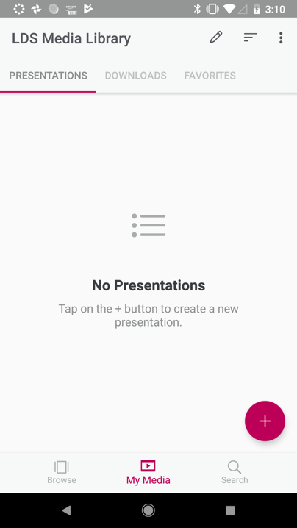
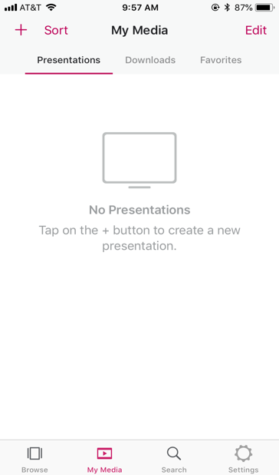
Create Presentations
How to create a new presentation
Notes:
SAY: Another powerful tool in the app that makes using media easier is creating Presentations.
If you plan to use more than one piece of media in a lesson, you can group them into a Presentation.
You can reorder them to match your lesson or however you want.
You can then play the items individually; or all at once, one right after the other.
ASK: How do you think a Gospel Media Presentation could improve a lesson?
Possible answers:
improves the flow of your lesson—saves you from taking time to search for each media piece during the lesson
allows you to set the order, matching the order of your lesson, before you get to class
ASK: Can you think of teaching situations where a Presentation could be helpful?

Slide 36
Create Presentations
How to create a new presentation
Notes:
SAY: To create a new presentation, Tap on the My Media icon in the bottom bar and then tap on the Presentations Tab.
To create a new presentation, you can tap on the “+” mark icon.

Slide 37
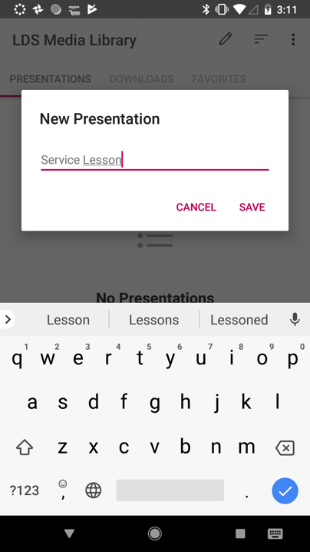
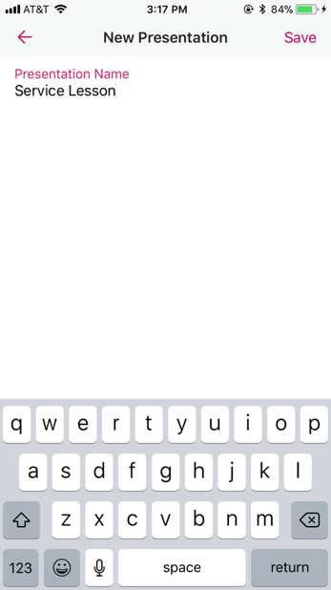
Create Presentations
How to create a new presentation
Notes:
SAY: You will be prompted to name your presentation. Type in what you’d like to call it and tap Save.
In this example, we are naming our presentation “Service Lesson”

Slide 38
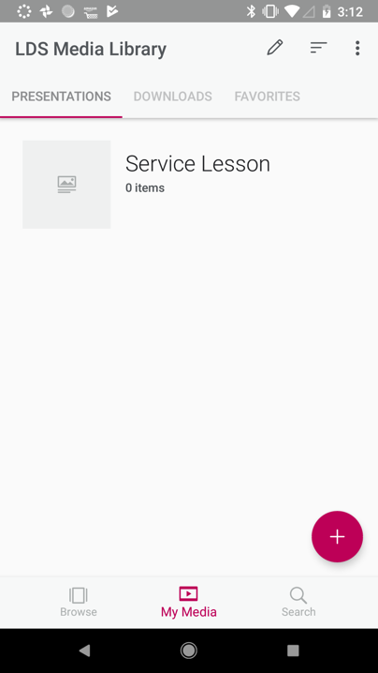
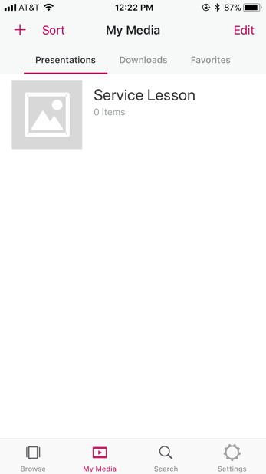
Create Presentations
How to create a new presentation
Notes:
SAY: Your new presentation has now been created. It currently is empty, but we will add media to our presentation. Tap on the “Service Lesson” to view the presentation.

Slide 39
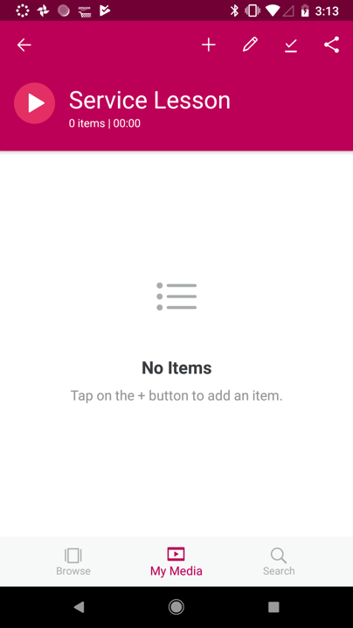
Create Presentations
How to add media to a presentation
Notes:
SAY: To add media to your presentation, tap on the “+” mark icon at the top of the screen.

Slide 40
Create Presentations
How to add media to a presentation
Notes:
SAY: To add media to your presentation, tap on the “+” mark icon at the top of the screen.
You will be taken to the Browse screen and can browse or search for Media to add to your presentation. While viewing media, tap on the “+’ mark at the top of each piece of media and it will automatically add it to your presentation.

Slide 41
Create Presentations
How to add media to a presentation
Notes:
SAY: You will be taken to the Browse screen and can browse or search for Media to add to your presentation.
While viewing media you want to add, tap on the “+” mark or “add to presentation icon” with the three lines and a +, at the top of each piece of media and it will automatically add it to your presentation.

Slide 42
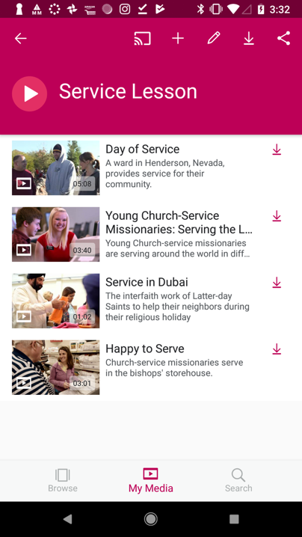
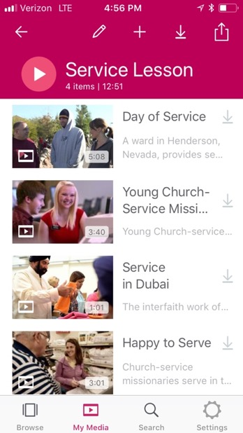
Create Presentations
How to edit media in a presentation
Notes:
SAY: Within the presentation screen, you have additional options under the EDIT icon which looks like a Pencil.
Within the Edit screen, you can DELETE individual media items, MOVE around the order of each media item, and RENAME the presentation.

Slide 43
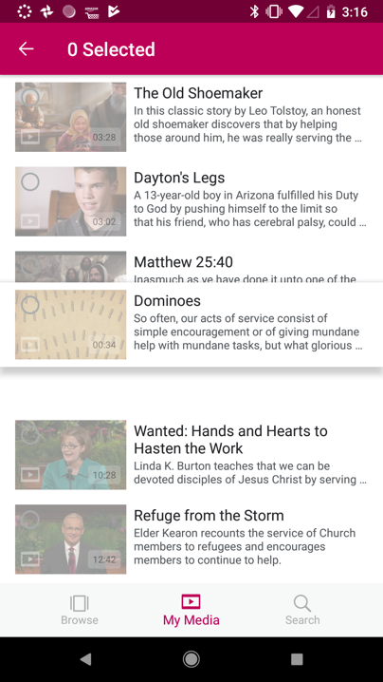
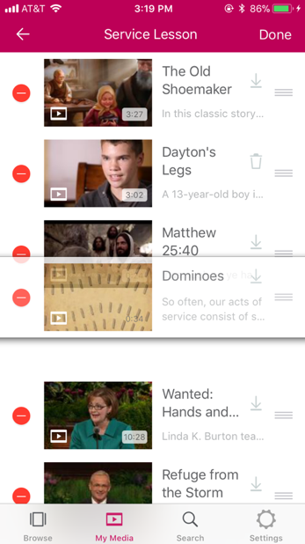
Create Presentations
How to move presentation media
Notes:
SAY: To rearrange the order of each media item, press and hold on the media item and move it to it’s new location within the presentation.
This option is available after you’ve tapped the Pencil icon in the Presentation screen.

Slide 44
Add Speaker Notes
How to add speaker notes
Notes:
SAY: As part of a Presentation, you can also add speaker notes to media items. You can add notes about the background or history of the item you are about to show, scripture references related to the item, or questions you want to ask the class after they have seen or listened to the item. Having your notes right in the palm of your hand can help your lessons go more smoothly.
To do this, tap on the media item you’d like to add notes to.

Slide 45
Add Speaker Notes
How to add speaker notes
Notes:
SAY: As part of a Presentation, you can also add speaker notes to media items. You can add notes about the background or history of the item you are about to show, scripture references related to the item, or questions you want to ask the class after they have seen or listened to the item. Having your notes right in the palm of your hand can help your lessons go more smoothly.
To do this, tap on the media item you’d like to add notes to.

Slide 46
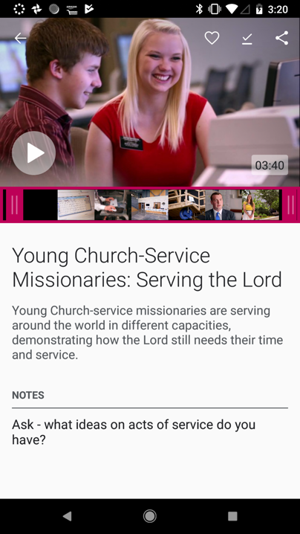
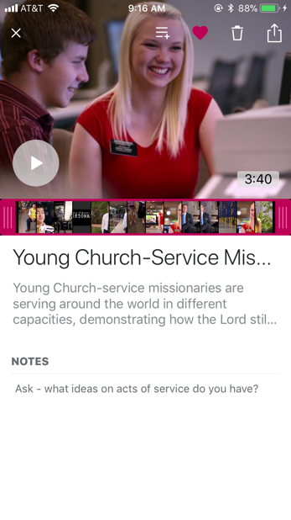
Add Speaker Notes
How to add speaker notes
Notes:
SAY: When viewing media within a presentation you can preview the media, trim the selection if it’s a video or piece of music, see the description, and add speaker notes.

Slide 47
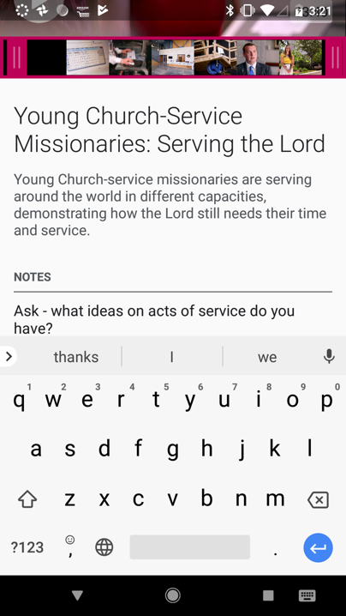
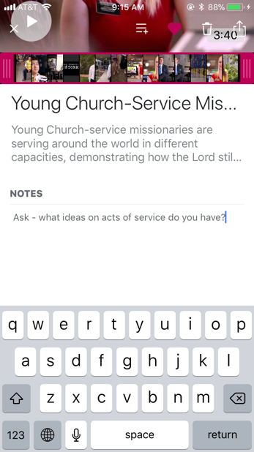
Add Speaker Notes
How to add speaker notes
Notes:
SAY: When viewing media within a presentation you can preview the media, trim the selection if it’s a video or piece of music, see the description, and add speaker notes.

Slide 48
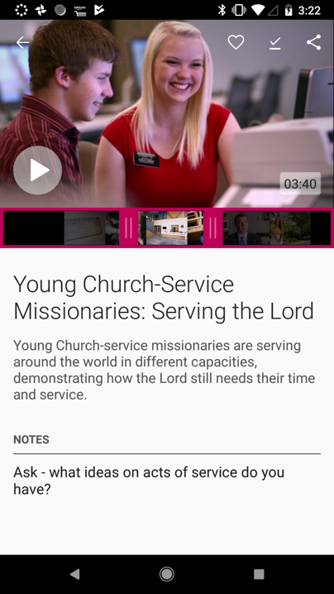
Trim Video and Audio
Notes:
SAY: Setting a start point or an end point is called “trimming,” and you can do it to any video or song in the app.
SAY: With this tool, there is no more fast forwarding through a video or General Conference talk trying to guess where to start it. You can set the start and end points while preparing your lesson and then in class, the video will start and end right where you want.

Slide 49
Trim Video and Audio
Notes:
SAY: Setting a start point or an end point is called “trimming,” and you can do it to any video, audio file, or song in the app.
SAY: With this tool, there is no more fast forwarding through a video or General Conference talk trying to guess where to start it. You can set the start and end points while preparing your lesson and then in class, the video will start and end right where you want.

Slide 50
View Presentation
Download to view offline
Notes:
SAY: While viewing your items in the presentation, you can see which items have been downloaded to your device or not. If the item still needs to be downloaded, you will see the download icon next to it. If it has been downloaded, there will be a trash can icon next to it.
You can download items one at a time, or you can tap on the download icon at the top and all of the items within this specific presentation will download to your device.
We recommend downloading the media within your presentation BEFORE coming to Church and presenting.

Slide 51
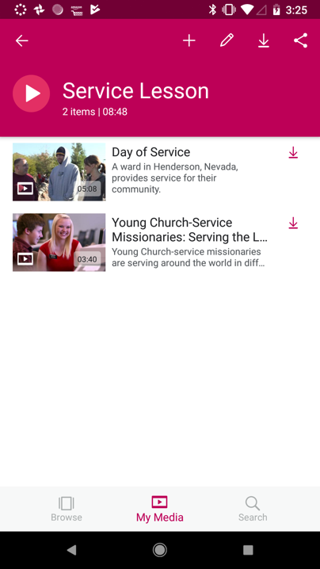
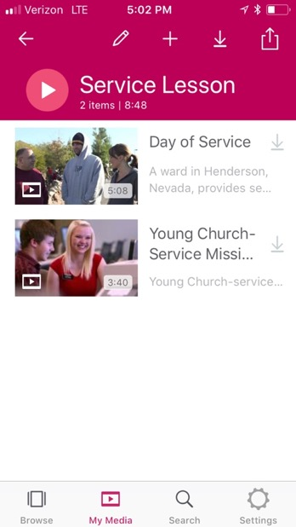
View Presentation
Notes:
SAY: Another useful tool in the app is Presenter Mode. Presenter mode allows you view your presentation at full screen on your device or connecting to a second screen, such as a TV or projector.
If you connect to a second screen, a TV, for example, you will see the media full screen. On the second screen (your device), you will see your notes for each item, see the next item, and manually move through or jump to items in your presentation.
While you can use AirPlay or Chromecast to present to a second screen, we recommend using an HDMI or VGA cable and adaptor to connect to a TV or projector when presenting where there is limited Wi-Fi, especially in Church buildings.
To play your presentation, tap on the Play button next to the Presentation Title.

Slide 52
View Presentation
Notes:
SAY: To play your presentation, tap on the Play button next to the Presentation Title.

Slide 53
View Presentation
Notes:
SAY: To advance to your next media slide, swipe from right to left.
To move back, you can swipe left to right.

Slide 54
View Presentation
How to advance to next video
Notes:
SAY: To advance to your next media slide, swipe from right to left.
To move back, you can swipe left to right.

Slide 55
Access Settings
How to sign into an LDS Account
Notes:
SAY: When using the app, you will want to sign in using your LDS account. This way your favorites, presentations, and downloads are backed up and you can access them on different devices.
To sign in, you will need to access the Settings menu in the bottom bar.

Slide 56
Access Settings
How to sign into an LDS Account
Notes:
SAY: When using the app, you will want to sign in to your LDS account. This way your favorites, presentations, and downloads are backed up and you can access them on different devices.
To sign in, you will need to access the Settings menu in the bottom bar.

Slide 57
Access Settings
How to sign into an LDS Account
Notes:
SAY: Within the Settings Menu, you can:
Sign in
Change the media language (currently available in Spanish and Portuguese)
Submit Feedback
View a complete User Guide with step by step instructions

Slide 58
Learn More: Gospel Media App page on ChurchofJesusChrist.org
www.ChurchofJesusChrist.org/pages/mobileapps/media-library-app-2.0
Frequently Asked Questions
Step-by-Step User Guides
Notes:
SAY: This brings us to the end of this presentation. We hope you have found this information about the Gospel Media app useful and that you will use it to make your lessons more engaging, powerful and meaningful.
To learn more about the app, go to the Gospel Media app page on ChurchofJesusChrist.org. You will find answers to frequently asked questions and user guides with step by step instructions.
To get the app, go to the app store on your device and search for Gospel Media.

