Slide 1
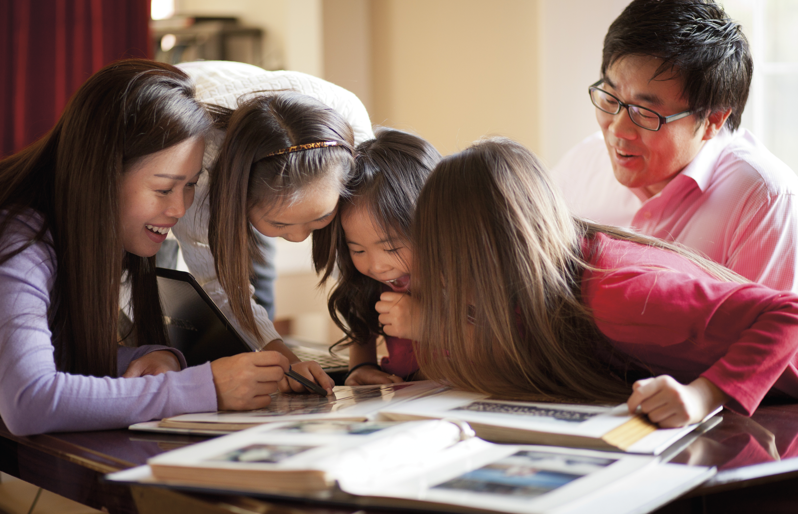
The power of memories and stories
Doctrine and Covenants 2:2
Notes:
“And he shall plant in the hearts of the children the promises made to the fathers, and the hearts of the children shall turn to their fathers.” D&C 2:2

Slide 2
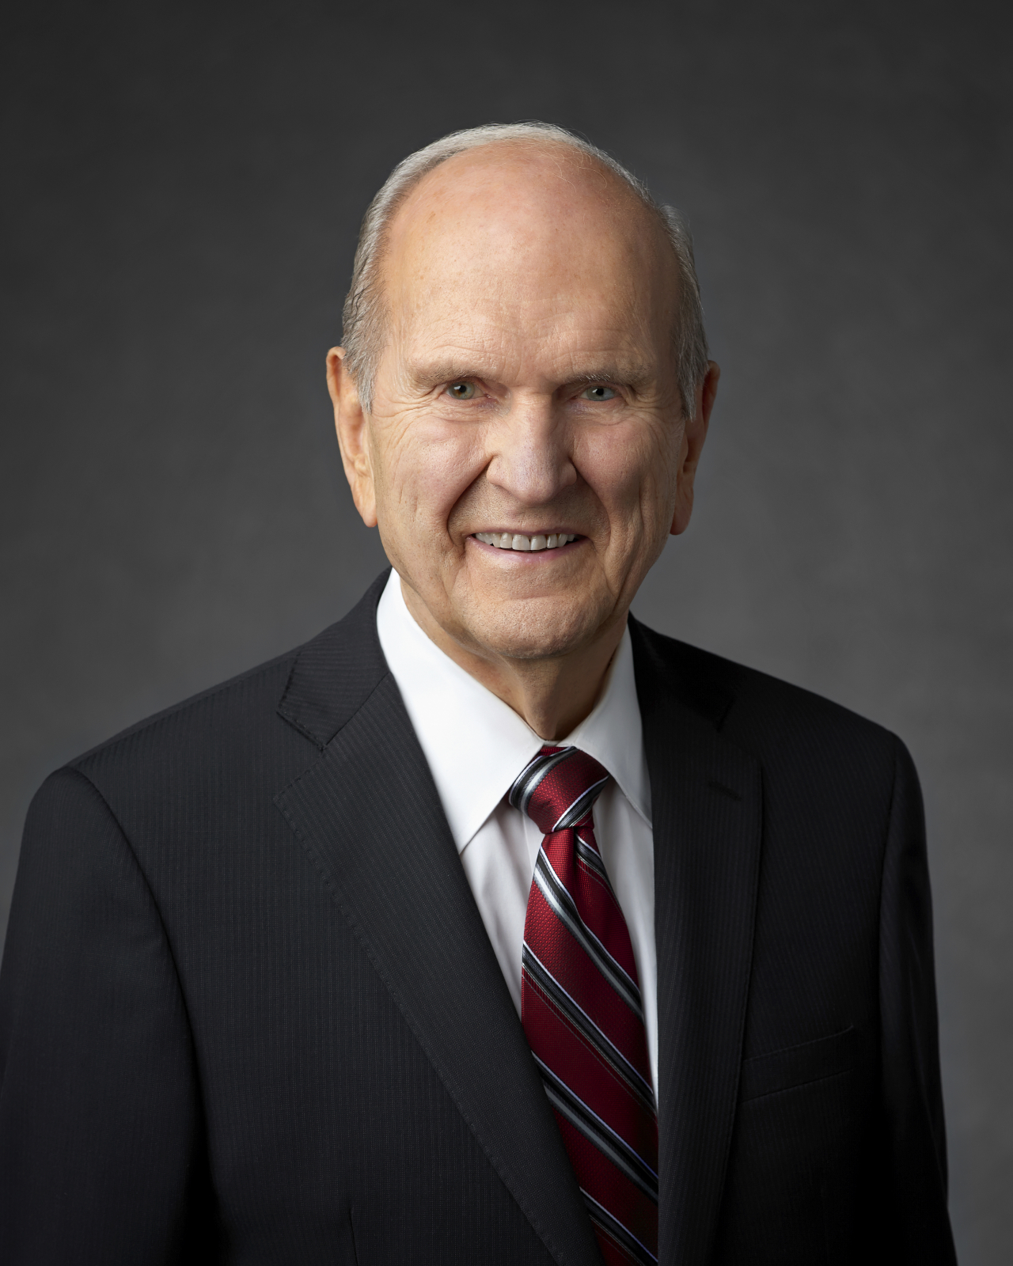
Modern Day Teaching
“While temple and family history work has the power to bless those beyond the veil, it has an equal power to bless the living. It has a refining influence on those who are engaged in it. They are literally helping to exalt their families.”
Pres. Russell M. Nelson, Ensign, May, 2010
Notes:
“While temple and family history work has the power to bless those beyond the veil, it has an equal power to bless the living. It has a refining influence on those who are engaged in it. They are literally helping to exalt their families.” President Russell M. Nelson, Ensign, 5/2010

Slide 3
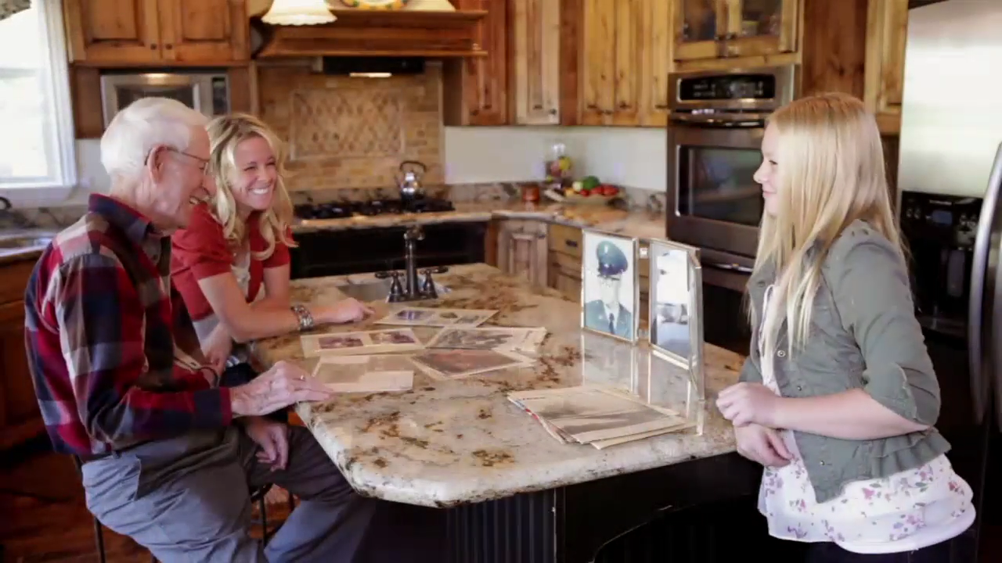
Notes:
12-year-old Whitney Black and her mother visit her great-grandfather, Elmo Patterson. He speaks to them about his experience rescuing other sailors during the Battle of Pearl Harbor. Whitney reflects on his courage—a trait of hers which she got from him.

Slide 4
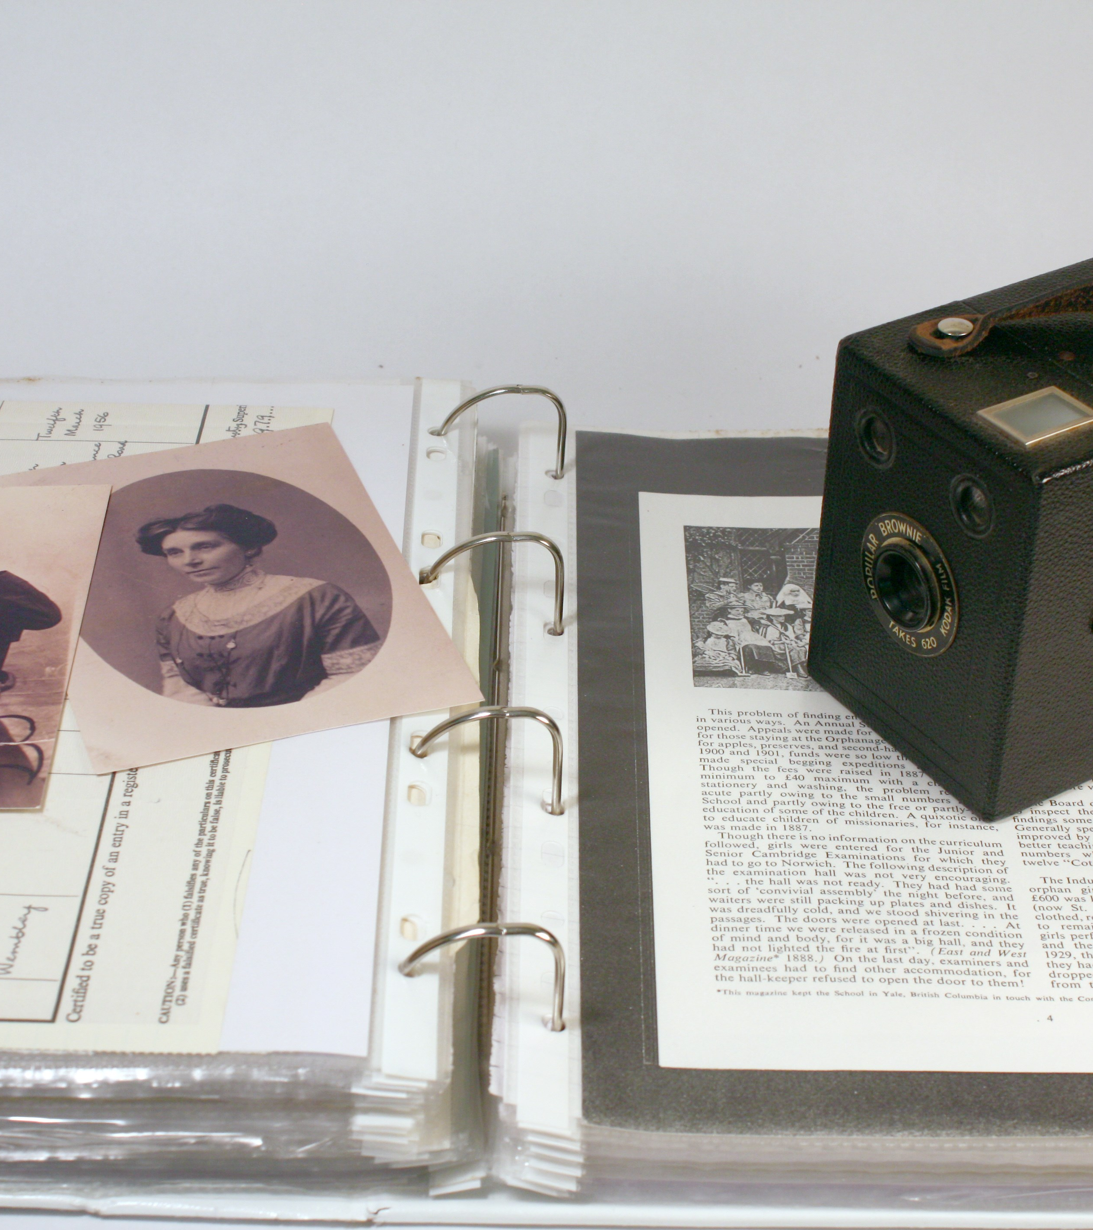
Possible Activities:
Discover your family
We bounce back – find a story about a time in the life of an ancestor where he or she tried something but it didn’t work out. What did he or she do, what did he or she learn?
Notes:
PERSON ON COMPUTER PICTURE

Slide 5
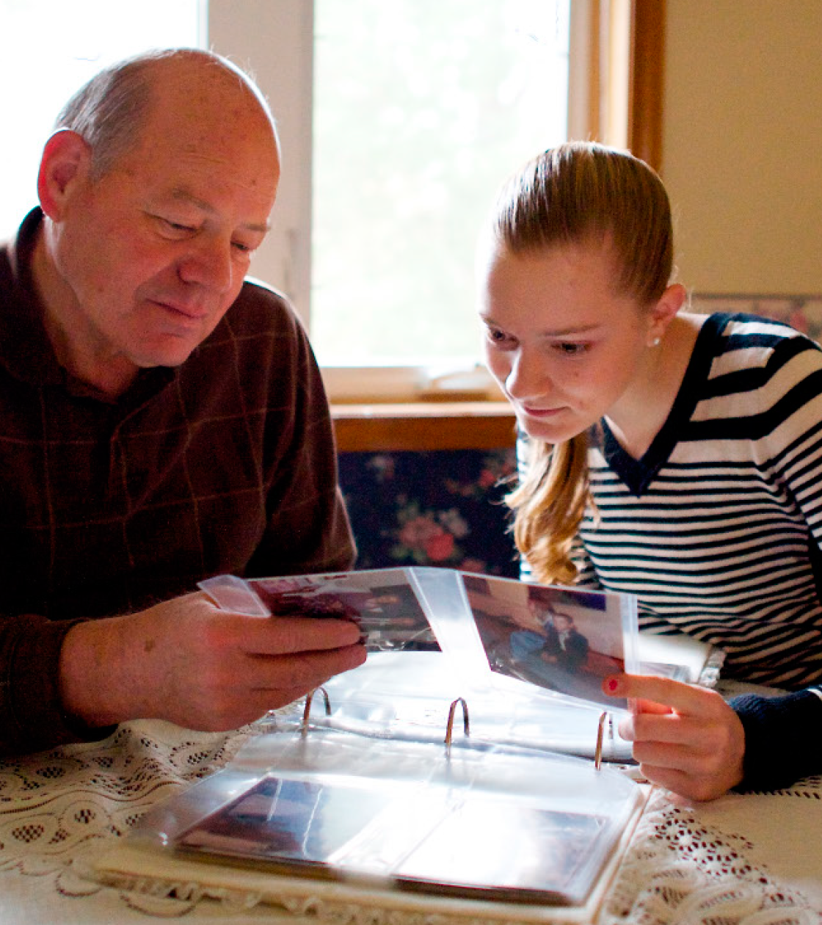
Possible Activities:
Discover your family
Listen to recordings of your family members’ stories to see what you can learn from them. Download and use the FamilySearch Memories App to record a story from a family members’ life so it won’t be lost.
Notes:
PERSON ON COMPUTER PICTURE

Slide 6

Possible Activities:
Discover your family
Go to FamilySearch Discovery to find a pioneer ancestor, a missionary or a Relief Society member. Consider, what were the family members’ personal costs of embracing the Gospel in their day?
Notes:
PERSON ON COMPUTER PICTURE

Slide 7
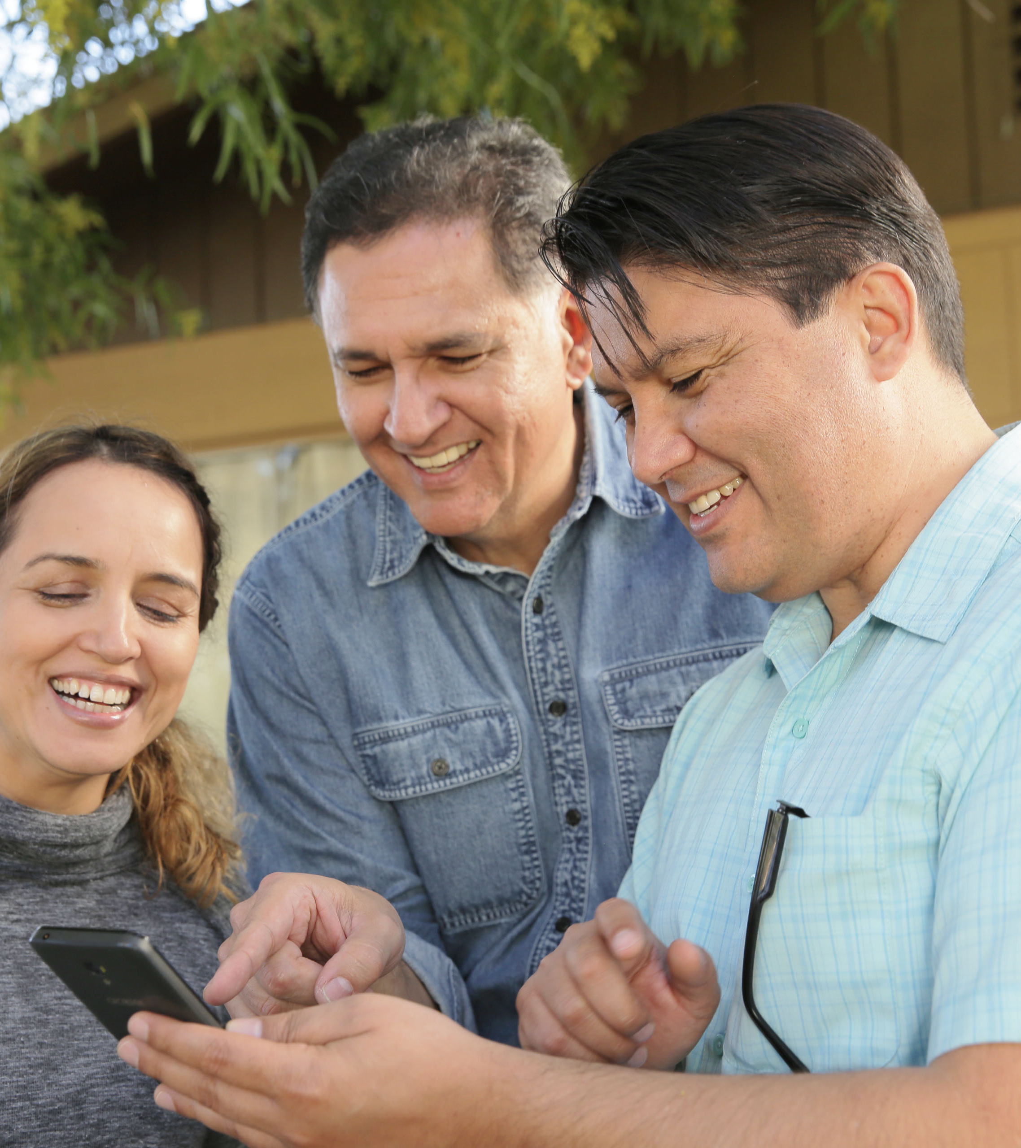
Possible Activities:
Discover who you are
Download the FamilySearch Memories app, and record an audio recording of a special event or fun story from your life.

Slide 8

Possible Activities:
Discover who you are
Find a couple of pictures that represent who you are or fun moments from your life. Log onto FamilySearch.org and upload that picture as a memory, explaining what that picture means to you. Then go to your person page, click on the person icon next to your name to set this photo as your portrait photo.

