Slide 1
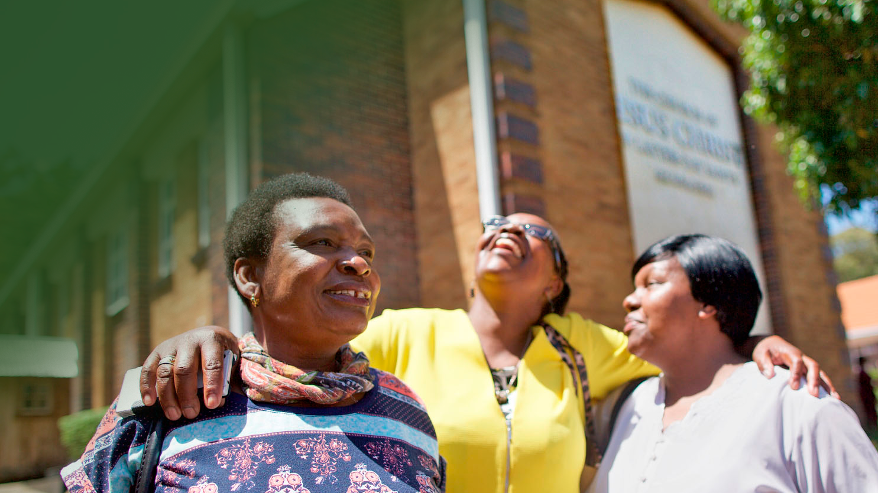
Sabbath day observance
Doctrine and Covenants 59:9-10
Notes:
And that thou mayest more fully keep thyself unspotted from the world, thou shalt go to the house of prayer and offer up thy sacraments upon my holy day;
For verily this is a day appointed unto you to rest from your labors, and to pay thy devotions unto the Most High; Doctrine & Covenants 59:9-10.

Slide 2
Modern Day Teaching
“You can experience true delight on the Sabbath from family history work. Searching for and finding family members who have preceded you on earth—those who did not have an opportunity to accept the gospel while here—can bring immense joy.”
Pres. Russell M. Nelson, Ensign, May 2015
Notes:
“You can experience true delight on the Sabbath from family history work. Searching for and finding family members who have preceded you on earth—those who did not have an opportunity to accept the gospel while here—can bring immense joy.” President Russell M. Nelson, Ensign, 5/2015
“We need to be spending more time in the temple and doing family history research, which includes indexing.” President Russell M. Nelson, RootsTech Family Discovery Day, 2017

Slide 3
Notes:
Mackenzie Hughes is a young busy student in Chorley, England. Mackenzie loves indexing. She teaches three generations of her family how to do it, and her enthusiasm is contagious.

Slide 4
Possible Activities: Discover your family
Find and index a batch of record images from your ancestral country or state.
Find a record – Look up an ancestor on FamilySearch.org that you feel draw to learn about, learn as much as you can by looking at the record.
Notes:
PERSON ON COMPUTER PICTURE

Slide 5
Possible Activities: Discover who you are
My timeline – Draw out or make a list of significant moments from the day you were born to today. Take a picture of your timeline and put it on FamilySearch.org as a memory.

Slide 6
Possible Activities: Discover who you are
Write an experience in your journal
Watch home movies
Look through old photo albums with family members
Visit family members and have them share memories

