Slide 1
Reaching Out
to Melchizedek Priesthood Holders and Their Families

Slide 2
“We ask that you prayerfully select one or more stake(s) within one or more of your Coordinating Councils and take the corresponding mission and stake presidents to meet with the bishops or the selected stakes.”

Slide 3
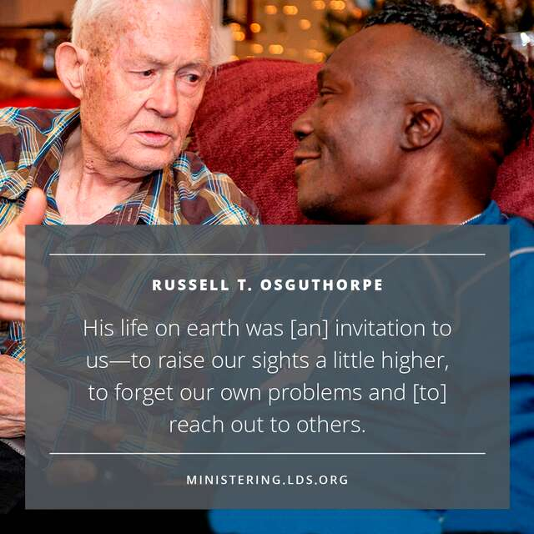
1. Mobilize the Ward Council
The ward council identifies and learns about less-active Melchizedek Priesthood holders
The ward council prayerfully selects two or three less-active MP holders and gathers as much information as possible about them.
The Ward Council identifies a fellowshipper(s) brother or couple that could best connect with the less-active MP holder.
The missionaries and fellowshipper(s) visit the less-active MP holder and his family.

Slide 4
2. Preparing for the Visit
The Ward Council member or Bishop meets with the selected fellowshiper(s) and missionaries to instruct and give direction on the purpose of the visit, including information about the less-active MP holder and his family.
The missionaries and the fellowshipper(s) set an appointment approximately a week in advance of the visit with the less-active MP holder.
  Appointments provide opportunity for spiritual preparation.
  The appointment must be made with the less-active priesthood holder – not his wife.

Slide 5
3. Visit the Individual or Family
Express love and appreciation for the opportunity to meet with him.
“We are here to visit you at the request of Bishop _____, and two apostles of Jesus Christ, Elder M. Russell Ballard and Elder Ronald A. Rasband.”
Connect and help them remember a time when they felt the spirit in their lives.
Listen intently. “People change by what they feel and not so much by what they know.” (Elder M. Russell Ballard)

Slide 6
3. Visit the Individual Family
Ask searching questions: “Why do you think the Lord inspired the Bishop and two Apostles to have us come to your home today?” Listen. They have been pondering this since the appointment was made and the Spirit has labored with them. The Spirit has spoken and they know.
Missionaries teach doctrine: Missionaries will teach a 15-minute lesson that engages the less-active MP holder with thought-provoking questions that teach in the Savior’s way. “True doctrine understood changes behavior.” (President Boyd K. Packer)

Slide 7
4. Visit the Individual Family
Promise blessings: Bear testimony of the blessings received when following God’s plan.
Exercise the Priesthood: …in the ordinances thereof, the power of godliness is manifest.” (D&C 84:20). If a blessing by the laying on of hands is not appropriate, leave a priesthood blessing through prayer. Use the Priesthood to help wake them up and feel again.

Slide 8
5. Follow Up as Needed
Help the returning Melchizedek brother and his family focus on the temple and priesthood ordinances. Help them accept callings or other responsibilities.

Slide 9
6. Continue in Prayer
Faithfully pray for those visited.
Trust that the Lord will provide.

Slide 10
Opportunity with Melchizedek Priesthood Holders

Slide 11
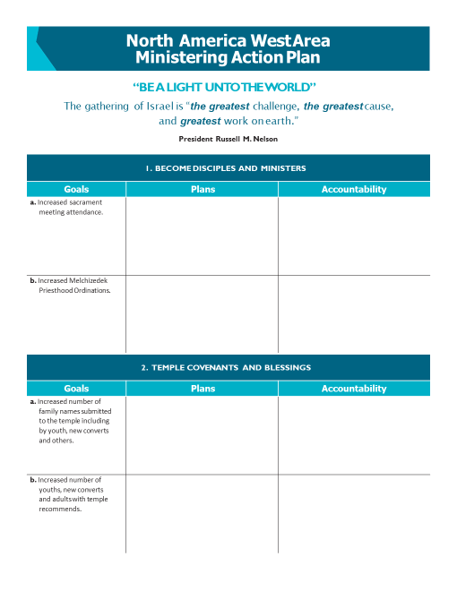
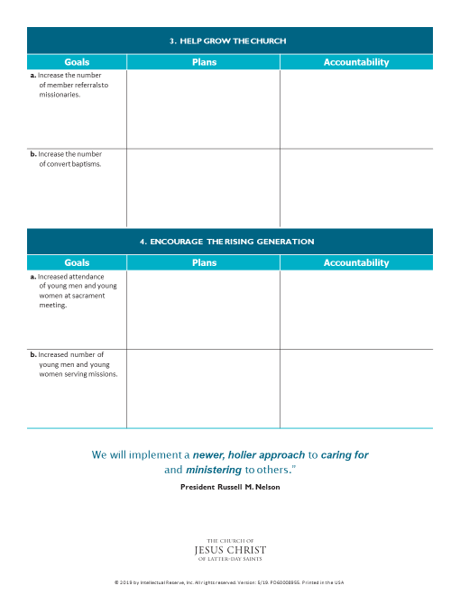
Ministering Action Plan

Slide 12
“Please can you continue to keep us updated with how many stakes you have introduced and how many have engaged.”

