Slide 1
Invite Someone to participate
Ephesians 1:10
Notes:
“That in the dispensation of the fulness of times he might gather together in one all things in Christ, both which are in heaven, and which are on earth; even in him.” Ephesians 1:10

Slide 2
Modern Day Teaching
“Preaching the gospel and seeking after our dead are complementary parts of one great work-a labor of love intended to change, turn, and purify the hearts of honest seekers of truth...”
Notes:
“Preaching the gospel and seeking after our dead are complementary parts of one great work—a labor of love intended to change, turn, and purify the hearts of honest seekers of truth. The artificial boundary line we so often place between missionary work and temple and family history work is being erased; this is one great work of salvation.” Elder David A. Bednar, Ensign, 10/2014

Slide 3
Modern Day Teaching
“…The artificial boundary line we so often place between missionary work and temple and family history work is being erased; this is one great work of salvation.”
Elder David A. Bednar, Ensign, Oct. 2010
Notes:
“Preaching the gospel and seeking after our dead are complementary parts of one great work—a labor of love intended to change, turn, and purify the hearts of honest seekers of truth. The artificial boundary line we so often place between missionary work and temple and family history work is being erased; this is one great work of salvation.” Elder David A. Bednar, Ensign, 10/2014

Slide 4
Notes:
One of the consultant video series films, the story of the Garcias shows how missionaries can work with Temple and Family History consultants to find investigators and to bring investigators to baptism.

Slide 5
Possible Activities: Discover your family
Set up a free account at FamilySearch.org and also download the free “Family Tree” mobile app
Print your fan chart and display it at home or at work
Share a story about someone in your family tree that you added or found
Notes:
__PERSON ON COMPUTER PICTURE

Slide 6
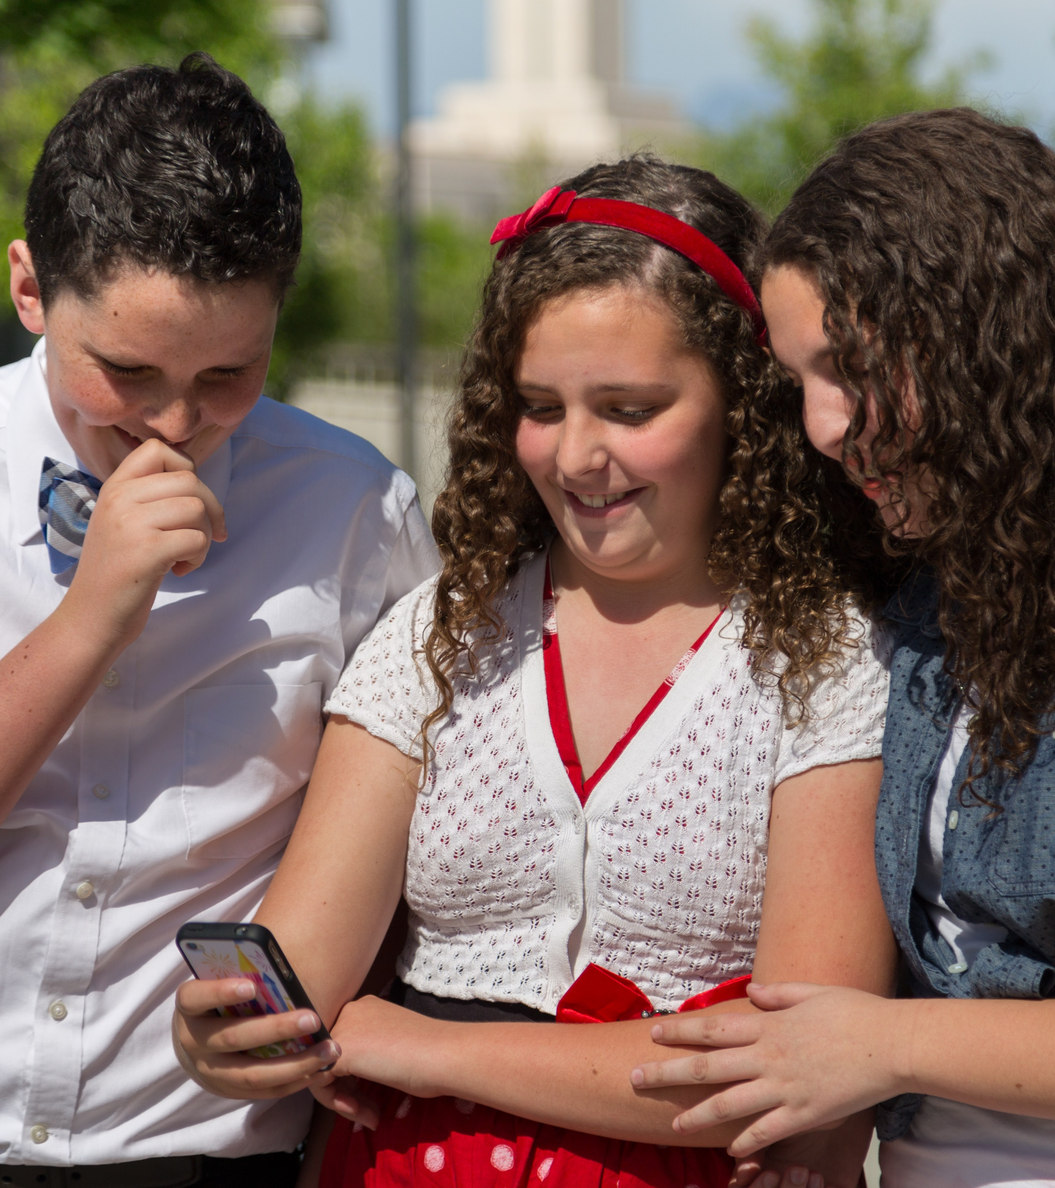
Possible Activities: Discover your family
Use the “Search for an Ancestor” feature on the Family Tree mobile app
Use the “Relatives Around Me” feature on the Family Tree mobile app to see how you might be related to each other
Notes:
PERSON ON COMPUTER PICTURE

Slide 7
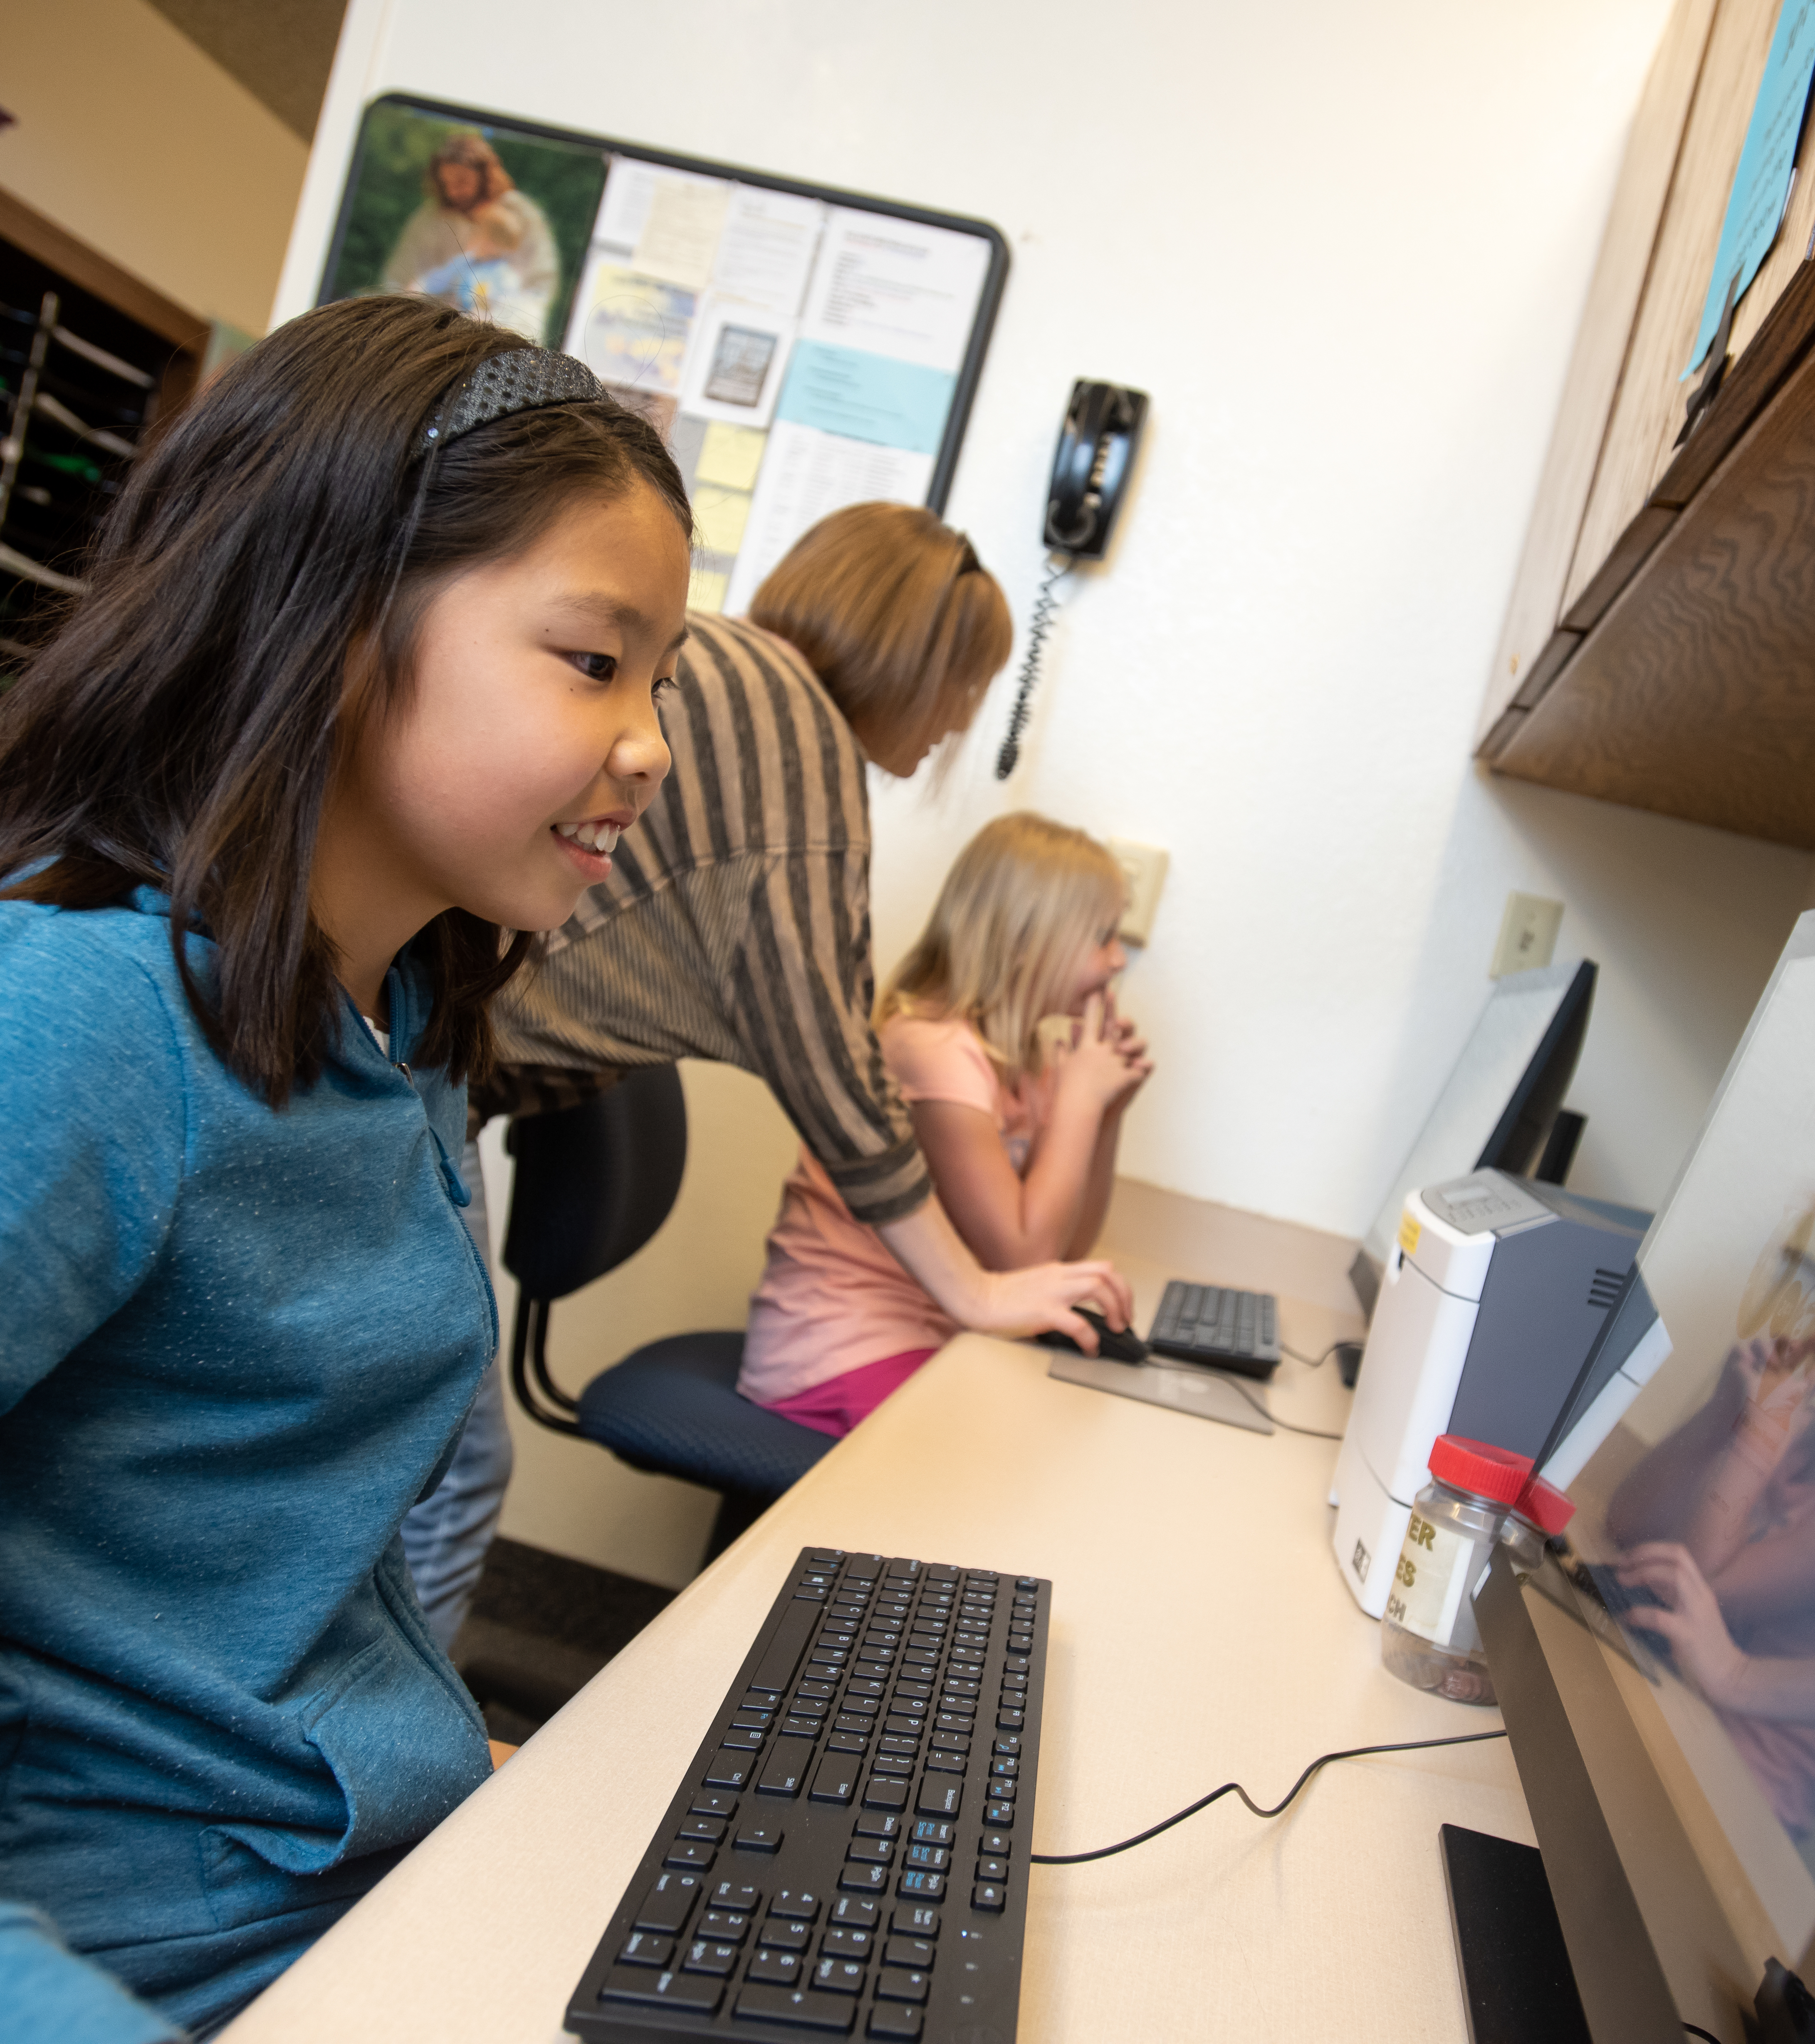
Possible Activities: Discover your family
Go to FamilySearch Discovery to use:
Compare-a-Face feature to see which ancestor you look the most like
Take the Ancestor Challenge to see how well you know your ancestors
Notes:
PERSON ON COMPUTER PICTURE

Slide 8
Possible Activities: Discover your family
Go to FamilySearch Discovery to use:
See the headstones, occupations, and obituaries of your ancestors
Notes:
PERSON ON COMPUTER PICTURE

Slide 9
Possible Activities: Discover who you are
Share old family photo albums and their memories. Pick one photo and a story to put on FamilySearch.org as a memory.
Take a photo or record a memory and upload it using the FamilySearch “Memories” app

Slide 10
Possible Activities: Discover who you are
Find out why you were given your name, and what your name means. Do any of your ancestors share that name?
Check on FamilySearch.org.

